Slide 1
malware development for fun and profit

Slide 2

Agenda
Warning
Windows Architecture
WinAPI
Antivirus/Endpoint Security
Development of Malware
Malware Demo (?)
Extra Research
Questions

Slide 3
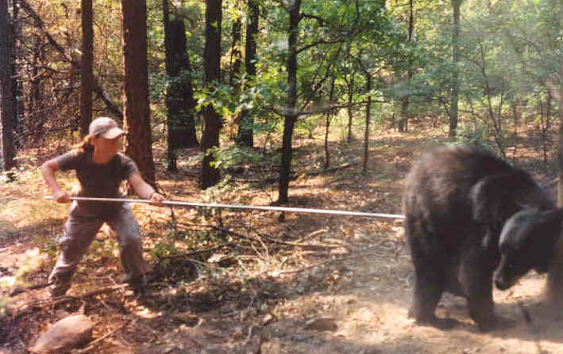
Warning
You
The Law
Curiosity

Slide 4
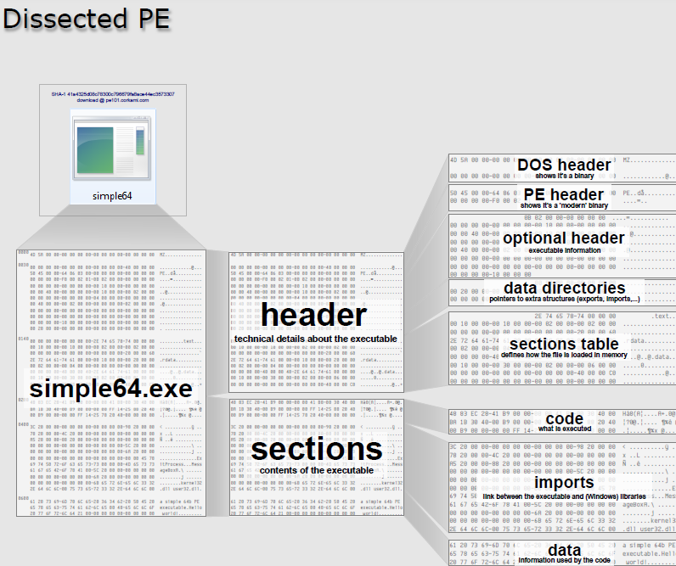
Windows arch. – PE files

Slide 5
Windows arch. – memory management
PE files and required dependencies are copied into memory
ASLR (Address Space Name Resolution) randomizes location
RVAs (Relative Virtual Addresses) within the PE file fix the random memory problem

Slide 6
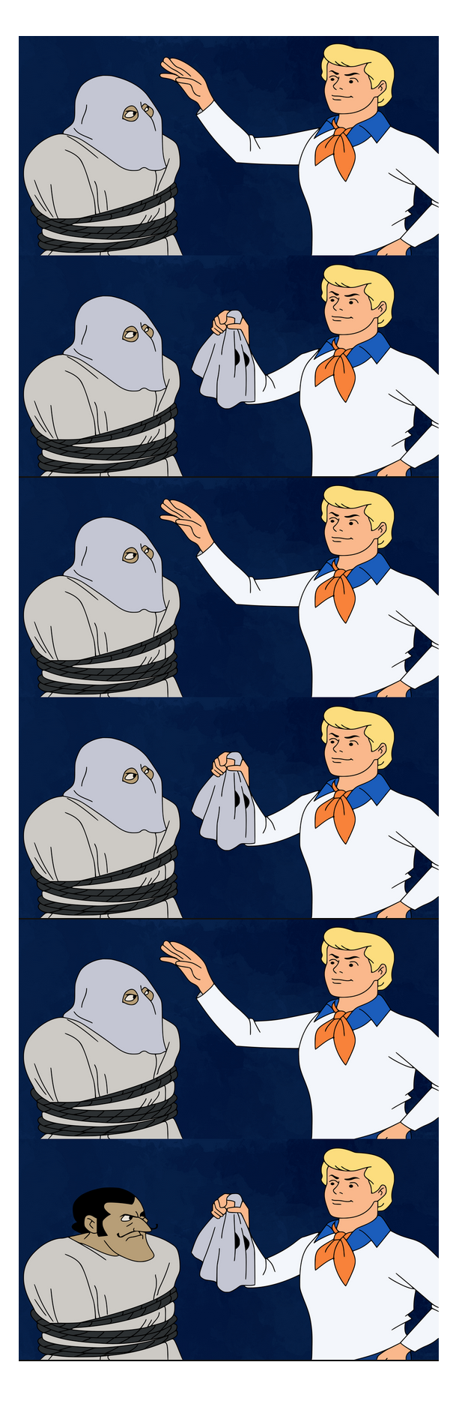
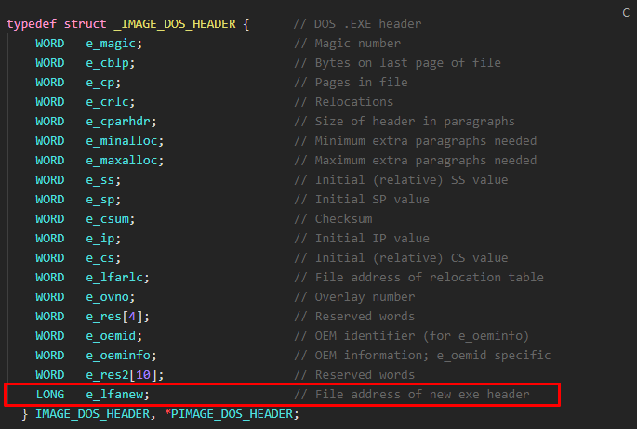
Windows arch. – Structs

Slide 7
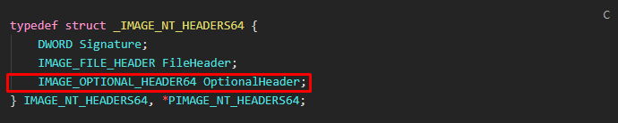
Windows arch. – Structs

Slide 8
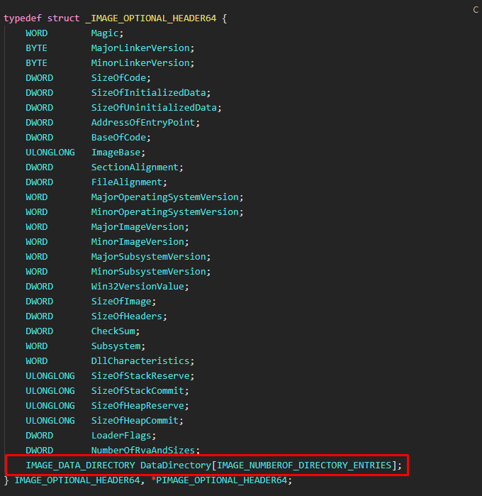
Windows arch. – Structs

Slide 9
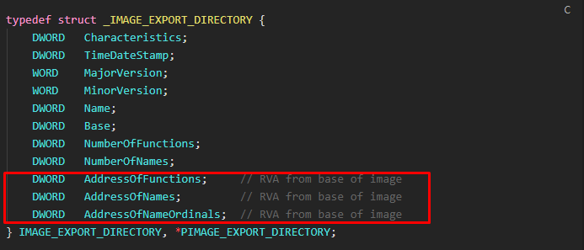
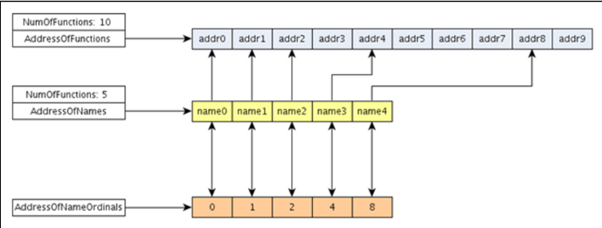
Windows arch. – Export address table (eat)

Slide 10
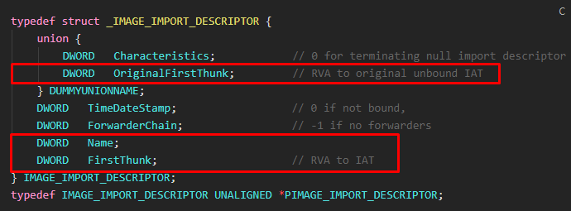
Windows arch. – Import address table (Iat)
Before: IAT = ILT
Import Descriptor Table (IDT) > Import lookup Table (ILT) > Import Address Table (IAT)
After: IAT != ILT

Slide 11
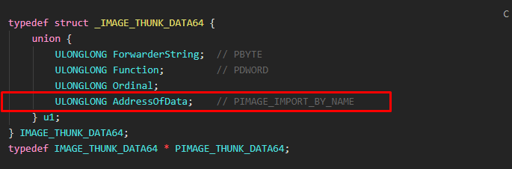
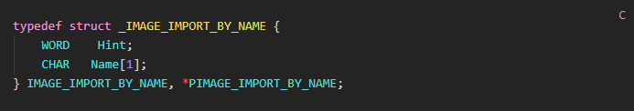
Windows arch. – Import address table (Iat)

Slide 12
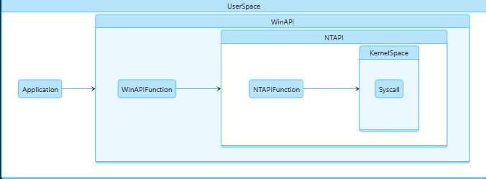
Windows arch. – Winapi

Slide 13
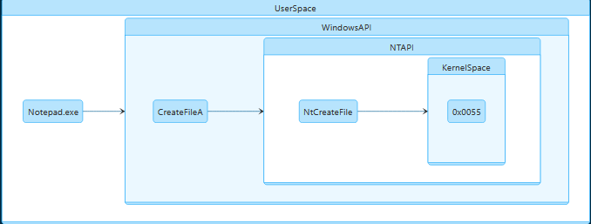
Windows arch. – Winapi

Slide 14
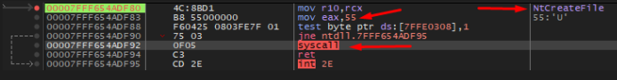
Windows arch. – Winapi

Slide 15
Antivirus/Endpoint Security
Two types of detection: Static and dynamic
Modern engines hook into the functions of DLLs in memory
Effectively “proxy” the function calls

Slide 16
Development of malware - methodology
First stage loader - injection
Bypass Windows Defender with known signatured shellcode
Basic MSF Venom payload with detection

Slide 17
Development of malware – avoiding detection
Encryption - bypass static analysis
Mapping memory – bypass dynamic analysis
Less common
Manipulate memory locally
Execution of shellcode – Get callback to listener

Slide 18
Demo time

Slide 19

Research

Slide 20

Demo time

Slide 21
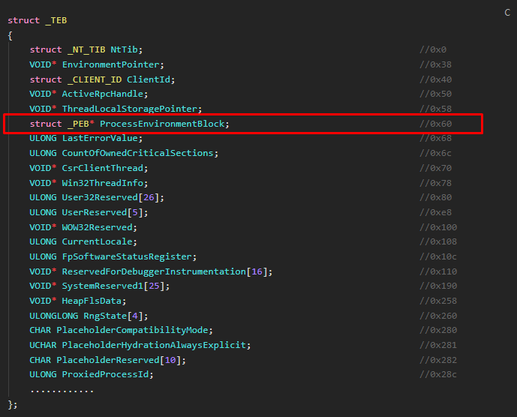
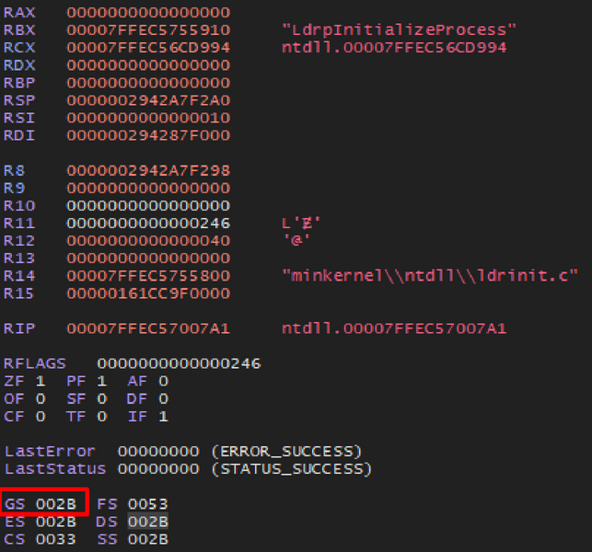
Windows arch. - TEB

Slide 22
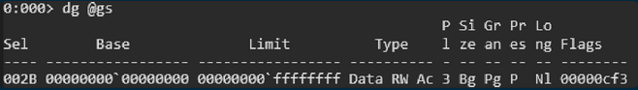
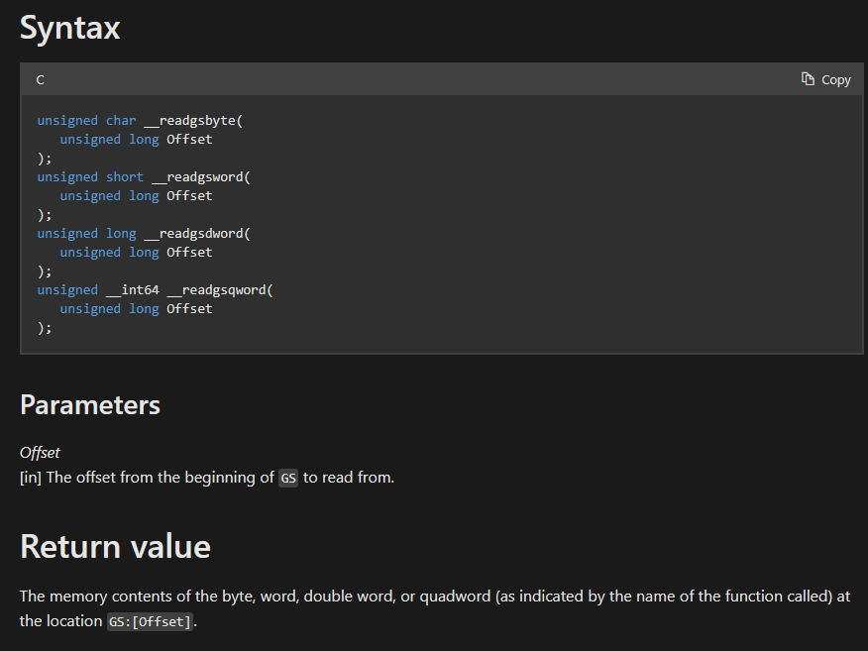
GS&FS Registers

Slide 23
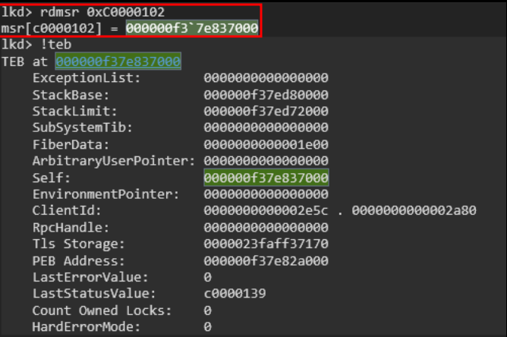
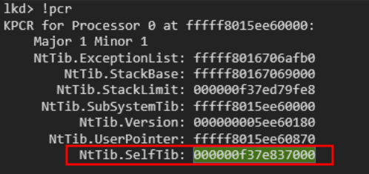
Windows arch. - Registers
IA32_GS_BASE: 0xC0000101
IA32_KERNEL_GS_BASE: 0xC0000102

Slide 24


Slide 25
GS Register

Slide 26
GS Register
TEB

Slide 27
GS Register
TEB
PEB

Slide 28
GS Register
TEB
TEB
PEB
Ldr

Slide 29
GS Register
TEB
TEB
PEB
Ldr
InMemoryOrderModuleList

Slide 30
GS Register
TEB
TEB
PEB
Ldr
TEB
InMemoryOrderModuleList
Table Entries

Slide 31
GS Register
TEB
TEB
PEB
Ldr
TEB
InMemoryOrderModuleList
Table Entries
DllBase/OriginalDllBase Address

Slide 32
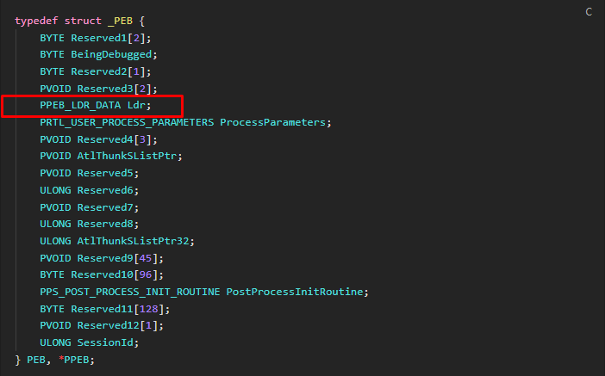
Windows arch. – PEB

Slide 33
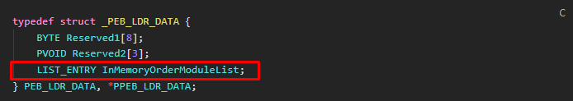
Windows arch. – PEB

Slide 34
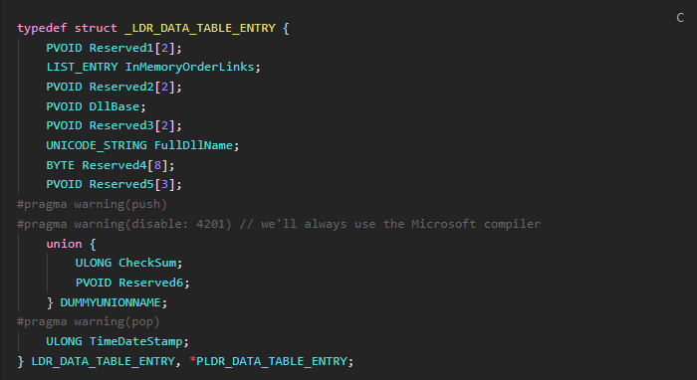
Windows arch. – PEB

Slide 35
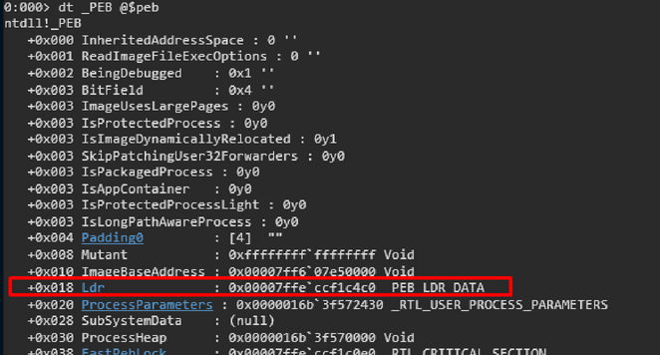
Theoretical proof of concept

Slide 36
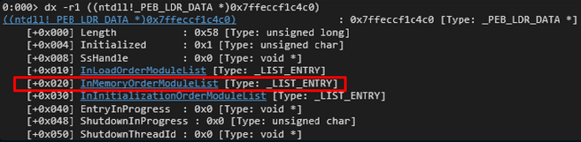
Theoretical proof of concept

Slide 37
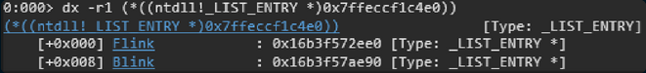
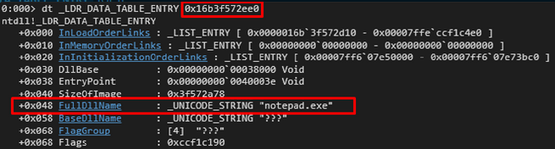
Theoretical proof of concept

Slide 38
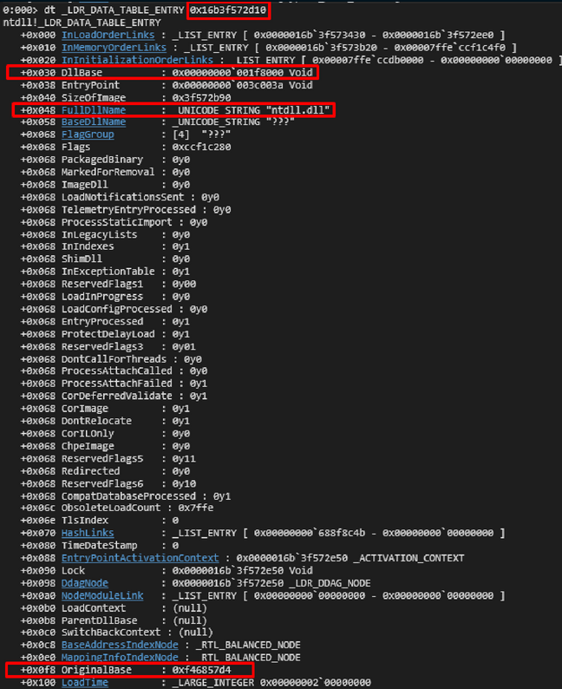
Theoretical proof of concept cont.

Slide 39
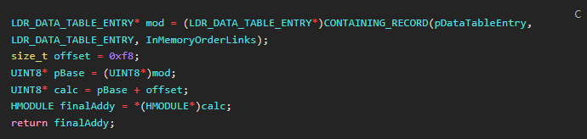
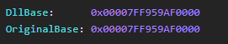
Theoretical proof of concept cont.

